Slide 1


Course Title: Artificial Intelligence (Machine Learning & Deep Learning) ATTENTION MECHANISM
Engr. Ahrar Bin Aslam
ahrar.aslam@admin.muet.edu.pk
Department of Telecommunication Engineering
Mehran University of Engineering and Technology

Slide 2
Introduction:
The attention mechanism is a powerful tool in deep learning that mimics how humans focus on specific parts of information. It allows models to selectively attend to relevant aspects of the input data, leading to more accurate predictions.
Imagine you're having a group project at school. You all have a giant pile of research to sort through. That's kind of like how a computer deals with information sometimes. It gets a lot of data at once, but it can be tricky to figure out what's most important.

Slide 3
Here's something cool called the “attention mechanism” that helps computers do just that. It's like having a spotlight in your brain for information! Here's how it works:
Highlighting the Important Stuff: Just like you'd focus on key points in your research, the attention mechanism helps computers highlight the most important parts of the information they're given.
Not All Information is Equal: Think about your group project. Some research might be super relevant to your topic, while other stuff might be more background noise. The attention mechanism gives more weight to the important info, just like you'd focus more on the key points.

Slide 4
3. Better Understanding: By focusing on the crucial details, the computer can make better sense of the information it's given. This helps it do things like translate languages more accurately or write clearer captions for pictures.
Importance of Attention Mechanism:
No More Info Overload: Without attention, computers would be overwhelmed by all the information at once. Attention helps them sort through it and find the most relevant pieces.

Slide 5
2. Giving Words Weight: Just like some words matter more in a sentence, attention gives different parts of the information different weights. Important things get a bigger weight, just like underlining key points in a text.
Computer Vision: This attention trick isn't just for languages! It’s used in computer vision too. Imagine helping a computer recognize house numbers on houses. Attention helps it focus on the right parts of the image, like doorways, to find the number.
“By using attention, computers can perform many tasks better, like translating languages, answering questions, and even recognizing objects in pictures. It's a powerful tool that helps them understand information in a smarter way.”

Slide 6
How Attention Mechanism Works?
Breaking Down the Input: Let’s say you have a bunch of words (or any kind of data) that you want the computer to understand. First, it breaks down this input into smaller pieces, like individual words.
Picking Out Important Bits: Then, it looks at these pieces and decides which ones are the most important. It does this by comparing each piece to a question or ‘query’ it has in mind.
Assigning Importance: Each piece gets a score based on how well it matches the question. The higher the score, the more important that piece is.

Slide 7
4. Focusing Attention: After scoring each piece, it figures out how much attention to give to each one. Pieces with higher scores get more attention, while less important ones get less attention.
5. Putting It All Together: Finally, it adds up all the pieces, but gives more weight to the important ones. This way, the computer gets a clearer picture of what’s most important in the input.
“ATTENTION IS ALL YOU NEED”
https://arxiv.org/abs/1706.03762
A. Vaswani, N. Shazeer, N. Parmar, J. Uszkoreit, L. Jones, A. N. Gomez, Ł. Kaiser, and I. Polosukhin, "Attention is all you need," in Advances in neural information processing systems, vol. 30, 2017.

Slide 8
Attention Mechanism Architecture
An attention mechanism is an Encoder-Decoder kind of neural network architecture that allows the model to focus on specific sections of the input while executing a task.
This mechanism is particularly valuable in tasks involving sequential or structured data, such as natural language processing or computer vision, as it enables the model to effectively handle long-range dependencies and improve performance by selectively attending to important features or contexts.

Slide 9
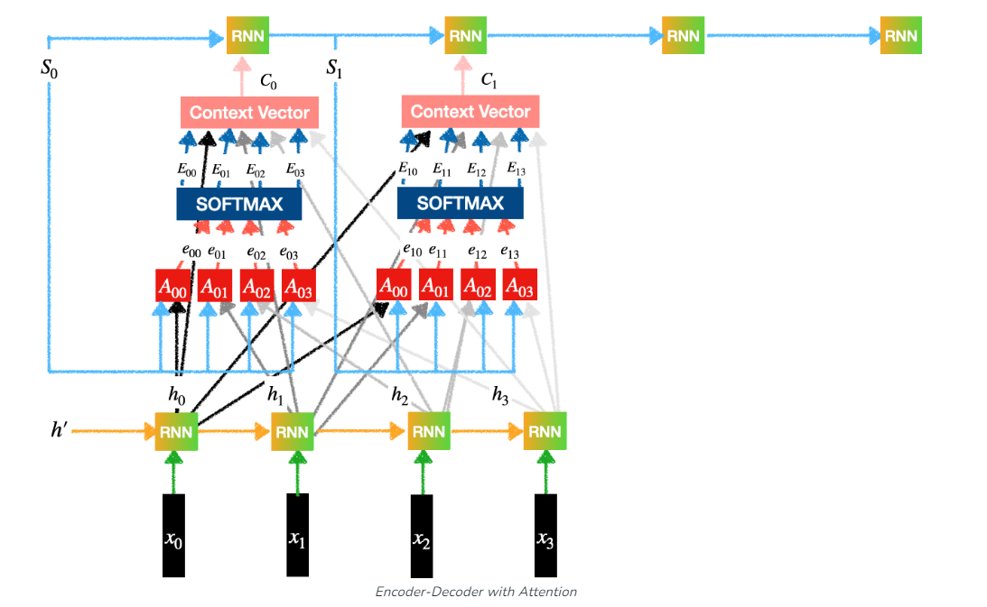
Attention Mechanism Architecture

Slide 10
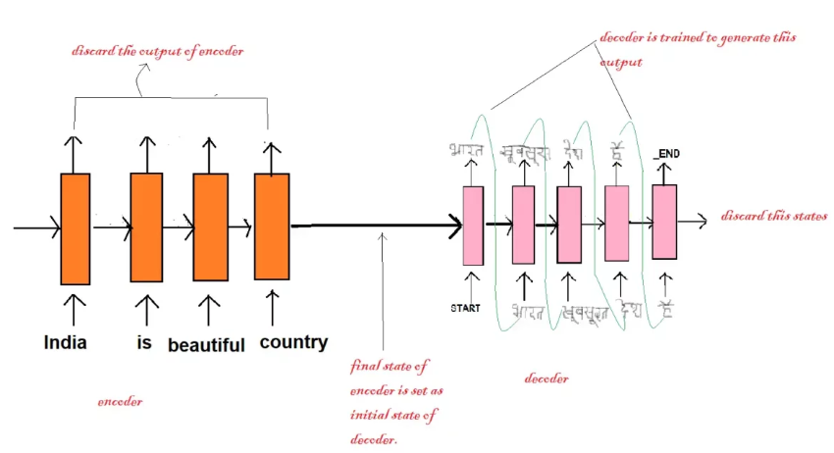

Slide 11
The Encoder: This part acts like the translator listening to a sentence in one language (source language). It processes the input sequence one element at a time (words in a sentence, pixels in an image) and uses a neural network to analyze each element. It then condenses this information into a shorter representation, capturing the key points. This compressed form is called a “context vector.”
The Decoder: This part acts like the translator speaking the other language (target language). It receives the context vector from the encoder, which summarizes the essential information from the input sequence. The decoder then uses this information to generate a new sequence of information (like a translated sentence) in the target format, one element at a time.

Slide 12
The attention mechanism acts like a smart assistant within the decoder, helping it focus on the most relevant parts of the input sequence.
Dynamic Weighting: Imagine highlighting different words in the source language sentence as the decoder builds the translated sentence. The attention mechanism assigns weights to each element in the source sequence. These weights indicate how important each element is to the current word being generated in the target sequence.
Context is Key: Unlike a simple weighting, the attention mechanism considers the context of the entire input sequence. It doesn't just focus on individual element importance but also on how they relate to each other and the current output being generated.

Slide 13
Imagine you're translating a sentence from English to French.
Traditional Weighting (ignores context):The encoder processes the sentence and creates a representation for each word. The decoder analyzes each word and assigns a weight based on its general importance. For example, nouns might get a higher weight than articles. Based on these weights, the decoder translates the sentence word-by-word.
Attention Mechanism (considers context):
The encoder processes the sentence and creates a representation for each word.
The decoder analyzes each word in the target language (French) it's trying to generate.

Slide 14
For each target word, the attention mechanism compares the decoder's current state with all the encoded word representations (English words).
It assigns a weight to each English word based on its relevance to the current target word being generated and the overall context
The decoder uses these weights to create a context-aware representation that considers all the English words, not just their individual importance.
Based on this context-aware representation, the decoder chooses the most appropriate word in French

Slide 15
HOW THE MECHANISM TRANSLATES:
Training on Massive Datasets: The model is trained on massive amounts of text data, including both English sentences and their corresponding different language translations. This data exposes the model to a vast vocabulary in both languages.
Word Embeddings: Each word in the training data is converted into a numerical representation called a “word embedding.” These embeddings capture the meaning and relationships between words. Imagine a map where similar words are positioned close together.
Encoder Learns Embeddings: During training, the encoder part of the model learns how to convert English words into their corresponding word embeddings.

Slide 16
Decoder Translates: When translating a new sentence, the encoder processes each English word and generates its embedding. The decoder then uses these embeddings and the attention mechanism to predict the most likely target language word for the translation, one word at a time.
Attention Mechanism Focuses: The attention mechanism helps the decoder focus on relevant parts of the English sentence.
Predicting the Next Word: Based on the context and the chosen embedding, the decoder predicts the most likely target language. It then repeats this process for each word in the English sentence, building the target translation.

